Slide 1
Quick Guide
Reminder Box By : N. Reyhan P

Slide 2
Detail Product
Product | Reminder Box
Dimension | 11.5 x 7.5 x 7 (cm)
Power Usage | Dc Adaptor 5v Direct Current (Avg)= 30~35mA
LCD | I2C 16X2
Operating Temperature | 10 °C – 45 °C

Slide 3

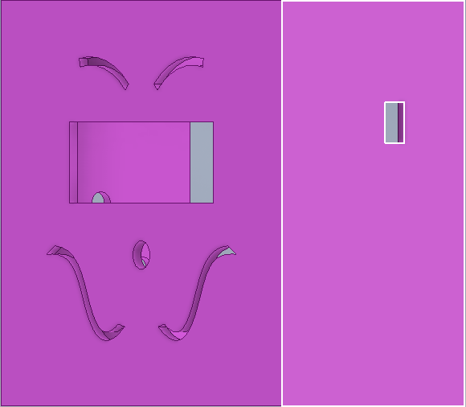
Deskripsi komponen :
1 PushButton Tactile LED, 1 Dc Adaptor 5v, LCD I2C 16x2, 1 ESP8266, Casing.
LCD I2C 16x2
Power Terminal
PushButton

Slide 4
Users Guide
Reminder Box

Slide 5
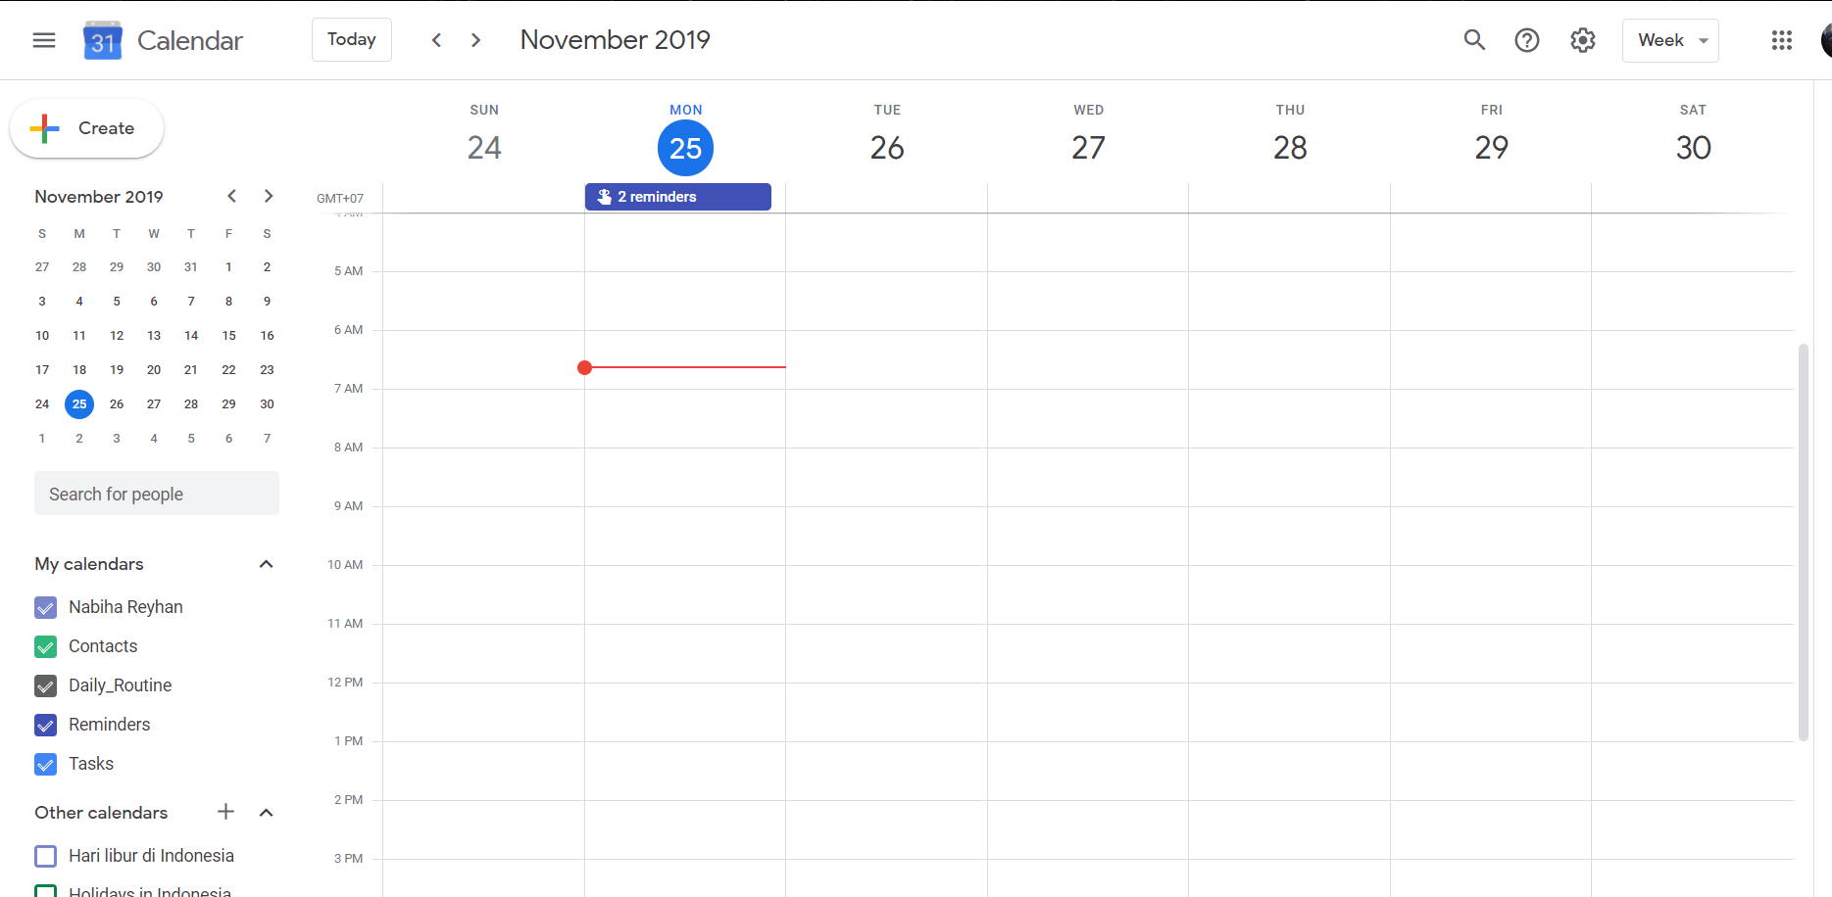
Set Judul dan Deskripsi pada Google Calendar
Saat Reminder Box terhubung ke jaringan internet maka akan menampilkan tugas yang tertera pada Gcal di waktu tersebut dan LED menyala.
Setelah melakukan tugas press LED maka akan mati menandakan tugas selesai.
LCD I2C 16x2
PushButton

Slide 6
Fitur Reminder Box
Pengingat selama tugas belum terselesaikan.
Dapat menjadwalkan tugas pada Gcalendar untuk semua pengguna yang terdaftarkan.
Setelah tugas terselesaikan, tugas yang sama tidak akan muncul kembali kecuali apabila di set ulang pada Gcalendar.
Menggunakan USB Charger sebagai supply
Versi single task dan multi task.

Slide 7
Technical Guide
Reminder Box

Slide 8
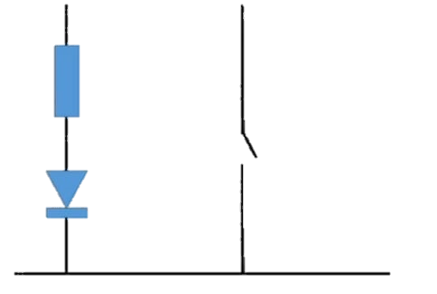
Embedded System
Tactile PushButtonLED
I2C LCD 16x2
GND
D4
D5
VCC
SDA
SCL
GND
GND
VCC
3V
GND
SDA
D2
SCL
D1

Slide 9
State Machine
NONE
Tugas dari Gcalendar
DUE
Tugas Menghilang
Tombol ditekan
DONE

Slide 10
Arduino IDE
void manageStatus() {
for (int i = 0; i < NBR_EVENTS; i++) {
switch (taskStatus[i]) {
case none:
if (taskHere(i)) taskStatus[i] = due;
break;
case due:
if (digitalRead(switchPins[i]) == false) taskStatus[i] = done;
break;
case done:
if (taskHere(i) == false) taskStatus[i] = none;
break;
default:
break;
}
}
yield();
}

Slide 11
Google Apps Script
//Data Calendar diperoleh microprocessor dari calendarName
function GetEvents(){
var _calendarName = 'Daily_Routine'
var Cal = CalendarApp.getCalendarsByName(_calendarName)[0];
//Penerapan fitur fitur yang dapat ditambahkan
str += events[i].getTitle() + '\n' ;
str += events[i].getDescription() + ';' ;
}
str = str.substring(0, str.length - 1);
return str;
}

Slide 12
Arduino IDE
#ifdef CREDENTIALS
const char* ssid = mySSID;
const char* password = myPASSWORD;
#else
const char* ssid = "Ooooo"; //replace with you ssid
const char* password = "kejardetlen"; //replace with your password
#endif
#define NBR_EVENTS 1 // Events yang ingin dimunculkan di reminder box
String possibleEvents[NBR_EVENTS] = {"Fitness"};
byte LEDpins[NBR_EVENTS] = {D4};
byte switchPins[NBR_EVENTS] = {D5};
// set LCD address, dengan ukuran LCD
LiquidCrystal_I2C lcd(0x27, 16, 2);

Slide 13
Arduino IDE
#ifdef CREDENTIALS
const char* ssid = mySSID;
const char* password = myPASSWORD;
#else
const char* ssid = "Ooooo"; //replace with you ssid
const char* password = "kejardetlen"; //replace with your password
#endif
#define NBR_EVENTS 1 // Events yang ingin dimunculkan di reminder box
String possibleEvents[NBR_EVENTS] = {"Fitness"};
byte LEDpins[NBR_EVENTS] = {D4};
byte switchPins[NBR_EVENTS] = {D5};
// set LCD address, dengan ukuran LCD
LiquidCrystal_I2C lcd(0x27, 16, 2);

Slide 14
Arduino IDE
#ifdef CREDENTIALS
const char* ssid = mySSID;
const char* password = myPASSWORD;
#else
const char* ssid = "Ooooo"; //replace with you ssid
const char* password = "kejardetlen"; //replace with your password
#endif
#define NBR_EVENTS 1 // Events yang ingin dimunculkan di reminder box
String possibleEvents[NBR_EVENTS] = {"Fitness"};
byte LEDpins[NBR_EVENTS] = {D4};
byte switchPins[NBR_EVENTS] = {D5};
// set LCD address, dengan ukuran LCD
LiquidCrystal_I2C lcd(0x27, 16, 2);

Slide 15
Arduino IDE
//Get calendar entries from google dengan menggunakan HTTPSRedirect library Serial.println("Start Request");
HTTPSRedirect client(httpsPort);
if (!client.connected()) client.connect(host, httpsPort);
calendarData = client.getData(url, host, googleRedirHost);
Serial.print("Calender Data ");
Serial.println(calendarData);
}
Source :
(https://github.com/electronicsguy/ESP8266/blob/master/HTTPSRedirect/HTTPSRedirect.h)

